Slide 1
MAE 5810: Robot perception Final Project
Haiyang Yu
hy397@cornell.edu

Slide 2
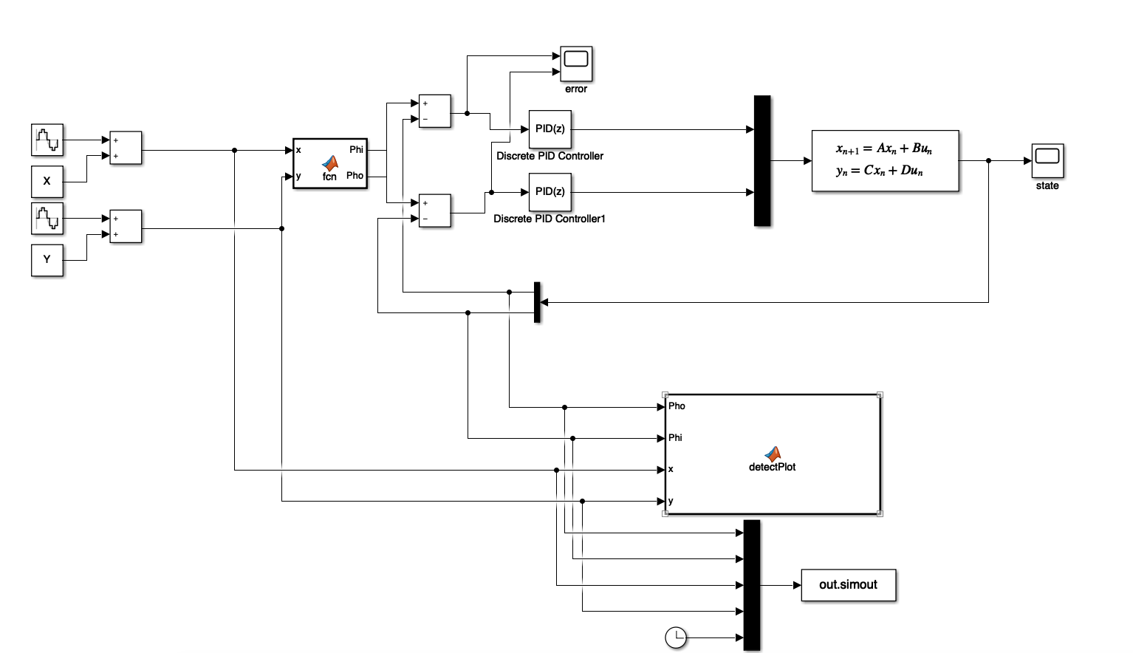
Tracking control (mentioned in the midterm project)
I Implement the feedback control to track a target. Dual PID controllers are used to control pan and tilt motor. In this project, the goal is to track the target. In other words, the camera will try to keep the target in the center of its field of view. A Matlab function is used to calculate the optimal pan and tilt angles such that the target is at the center of FOV. And another function is used to plot the target and FOV in the 3D workspace.

Slide 3
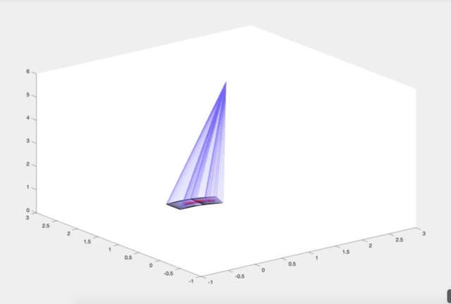
Tracking control (mentioned in the midterm project)
Scenario 1:
In the first scenario, the target moves in a uniform circular motion with the point (1,1) as the center of the circle. The angular velocity of the target is 0.5 rad/s. The duration of the scenario is 8 seconds. Video 1 shows the field of view and the target location during the process. The target is shown by red point, the FOV is shown as the blue quadrilateral on the button surface.
Video 1: tracking uniform circular motion target

Slide 4
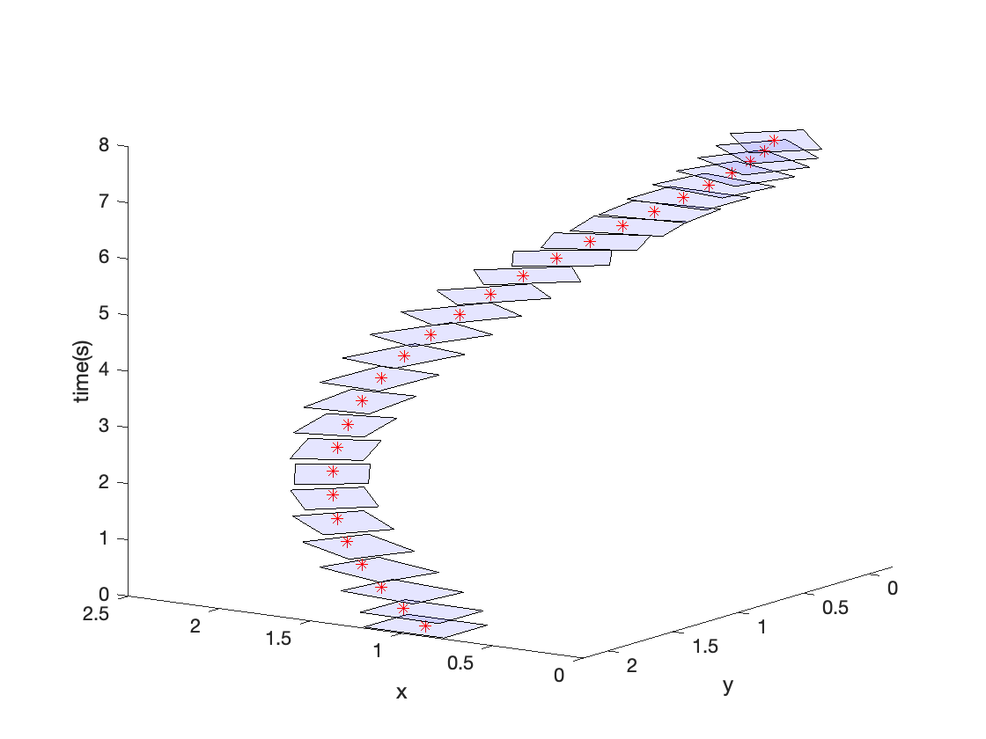
Tracking control (mentioned in the midterm project)
Scenario 1:
To clearly illustrate the moving process of FOV and target, I constructed a model where x and y axis represent the location of FOV and target on the bottom. The z axis represent the time of that frame. In other words, while cutting the 3D model perpendicular to the z-axis, we can intuitively see the FOV and target at a certain time point. The FOV and target movement is shown in Figure 1.
Figure 1: FOV and target at every time point

Slide 5
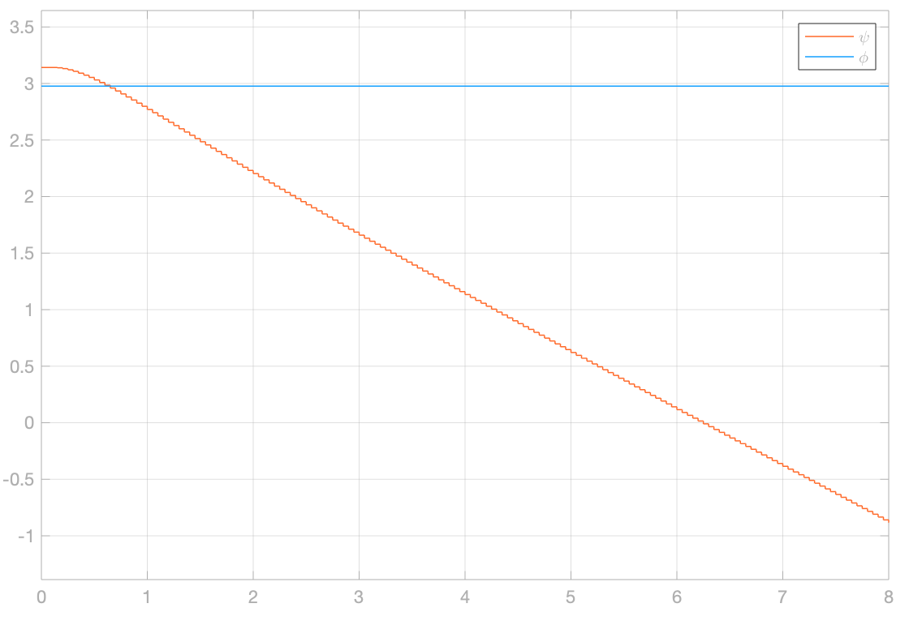
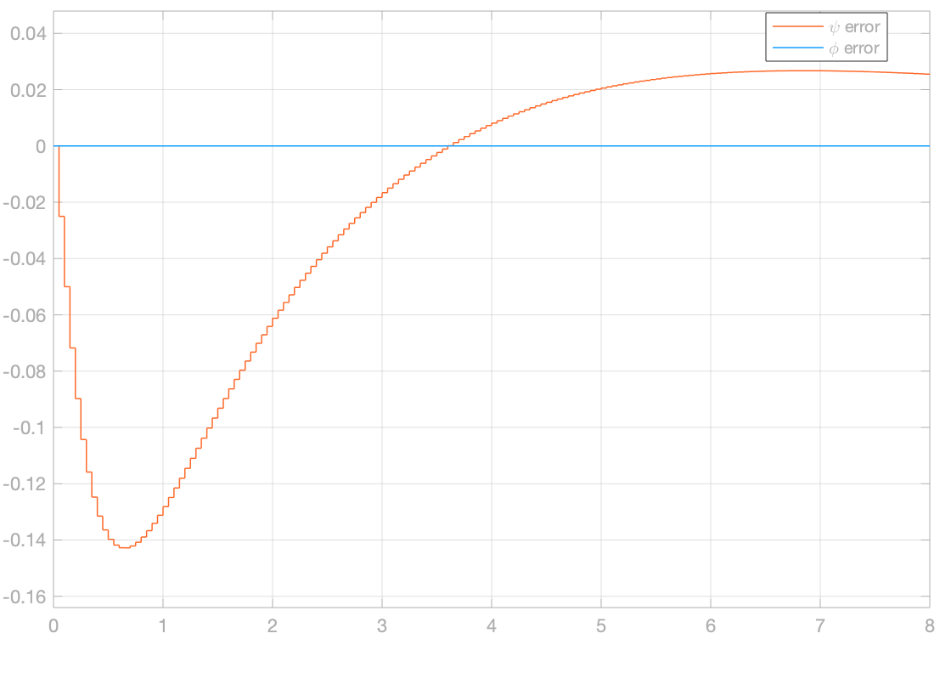
Tracking control (mentioned in the midterm project)
Results of scenario 1:
Figure 2 shows the states during the process. Since the target moves in a uniform circular motion around the camera, the tilt angle during the process doesn't change. Due to the characteristics of the PID controller, there is a delay of the tilt angular movement at the beginning. Figure 3 illustrates the error between current pan and tilt angle and the desired angles to capture the target in the center of FOV.
Figure 2: States in scenario 1
Figure 3: errors in scenario 1

Slide 6
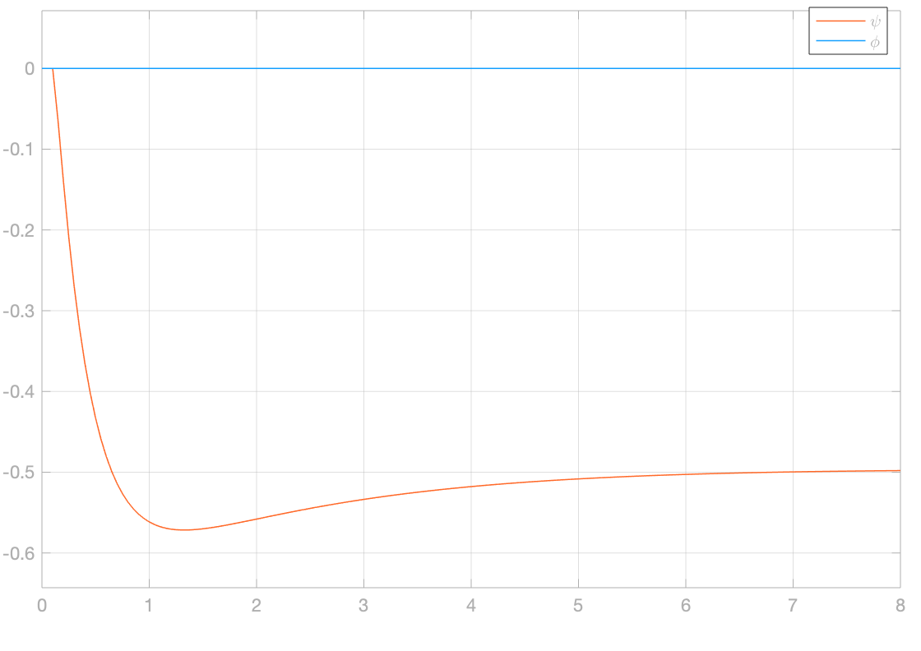
Tracking control (mentioned in the midterm project)
Results of scenario 1:
The angular speed of pan and tilt angle is shown in figure 4 (in rad/s). It is within the constrain.
Figure 4: angular velocity of pan and tilt angle in scenario 1

Slide 7
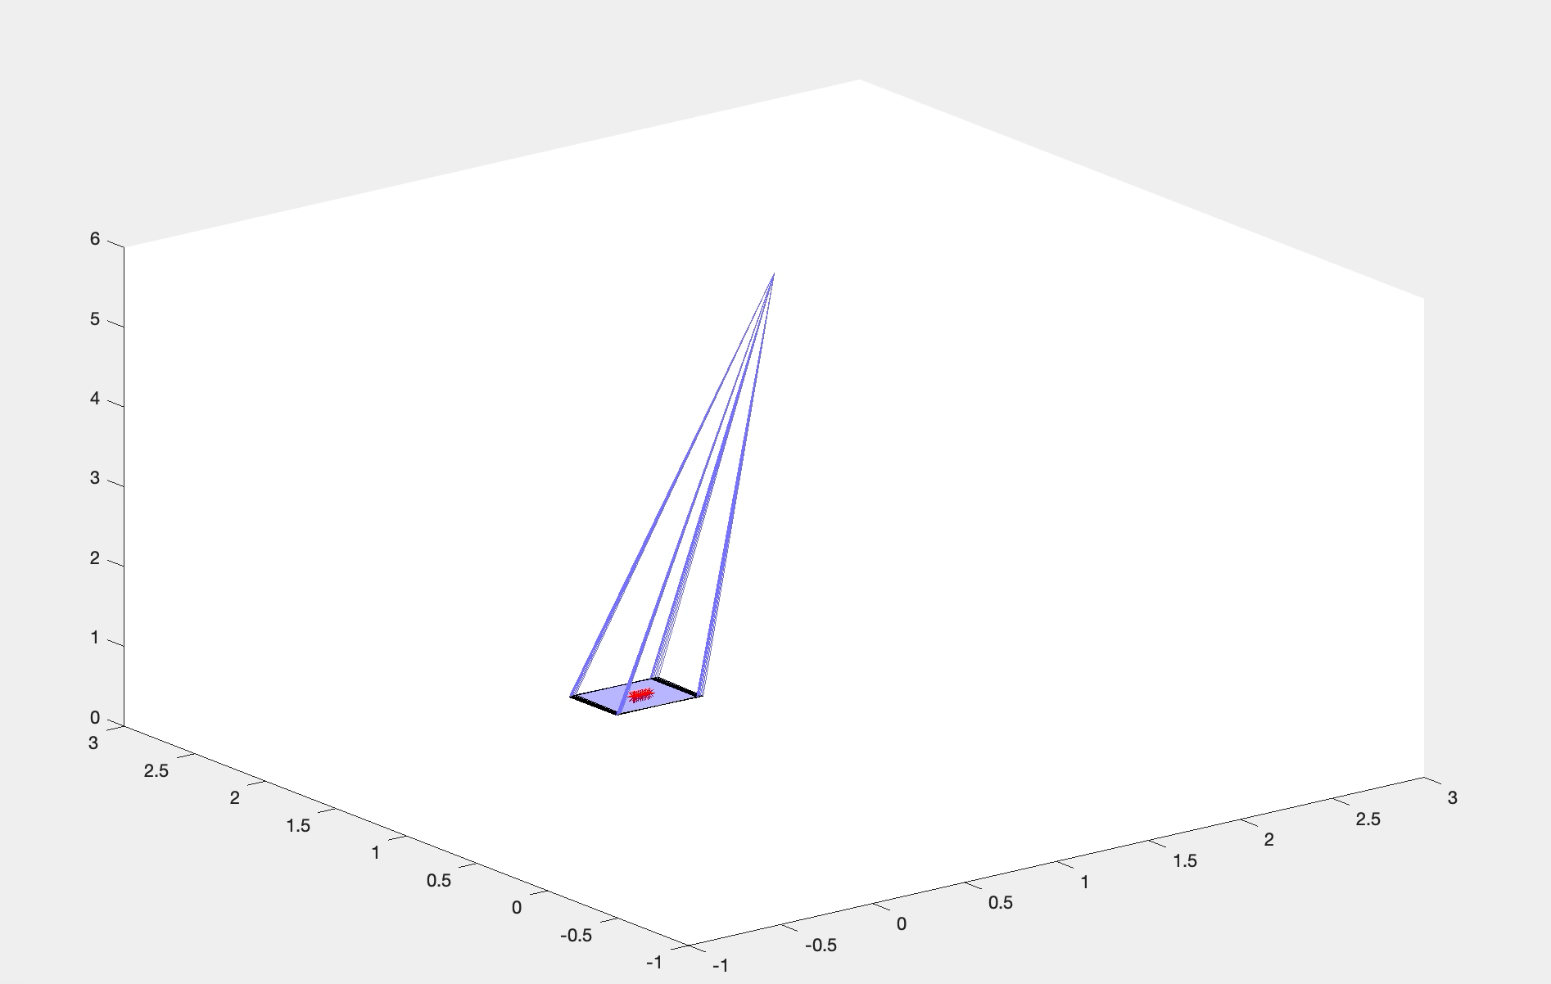
Tracking control (mentioned in the midterm project)
Scenario 2:
In the second scenario, The target moves along the y-axis with uniform linear motion parallel to the Y axis. The speed of the target is 0.2 m/s. The duration of the scenario is 8 seconds. Video 2 shows the field of view and the target location during the process. The target is shown by red point, the FOV is shown as the blue quadrilateral on the button surface.
Video 2: tracking uniform straight motion target

Slide 8
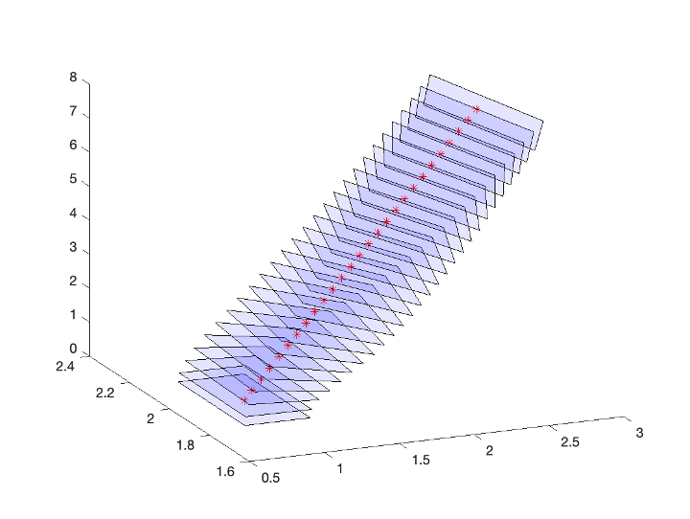
Tracking control (mentioned in the midterm project)
Scenario 2:
Using the same method as Figure1. The FOV and target movement at every time point is shown in Figure 5
Figure 5: FOV and target at every time point

Slide 9
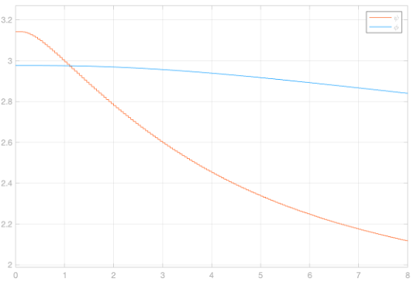
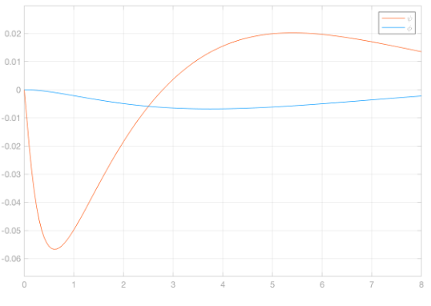
Tracking control (mentioned in the midterm project)
Results of scenario 2:
Figure 6 shows the states during the process. The pan and tilt angle should change over time in this scenario. Figure 7 illustrates the error between current pan and tilt angle and the desired angles to capture the target in the center of FOV. The error is affordable during both scenarios
Figure 6: States in scenario 2
Figure 7: errors in scenario 2

Slide 10
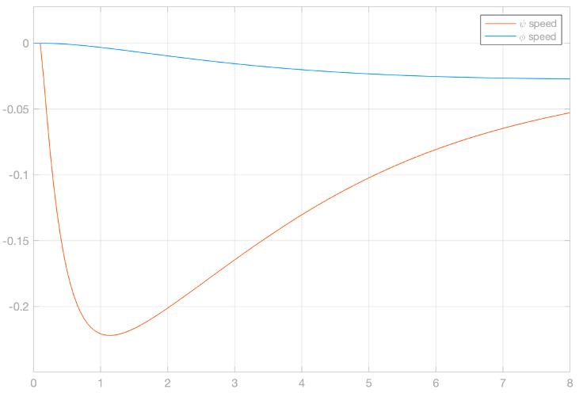
Tracking control (mentioned in the midterm project)
Results of scenario 2:
The angular speed of pan and tilt angle in scenario 2 is shown in figure 8 (in rad/s). It is within the constrain.
Figure 8: angular velocity of pan and tilt angle in scenario 2

Slide 11
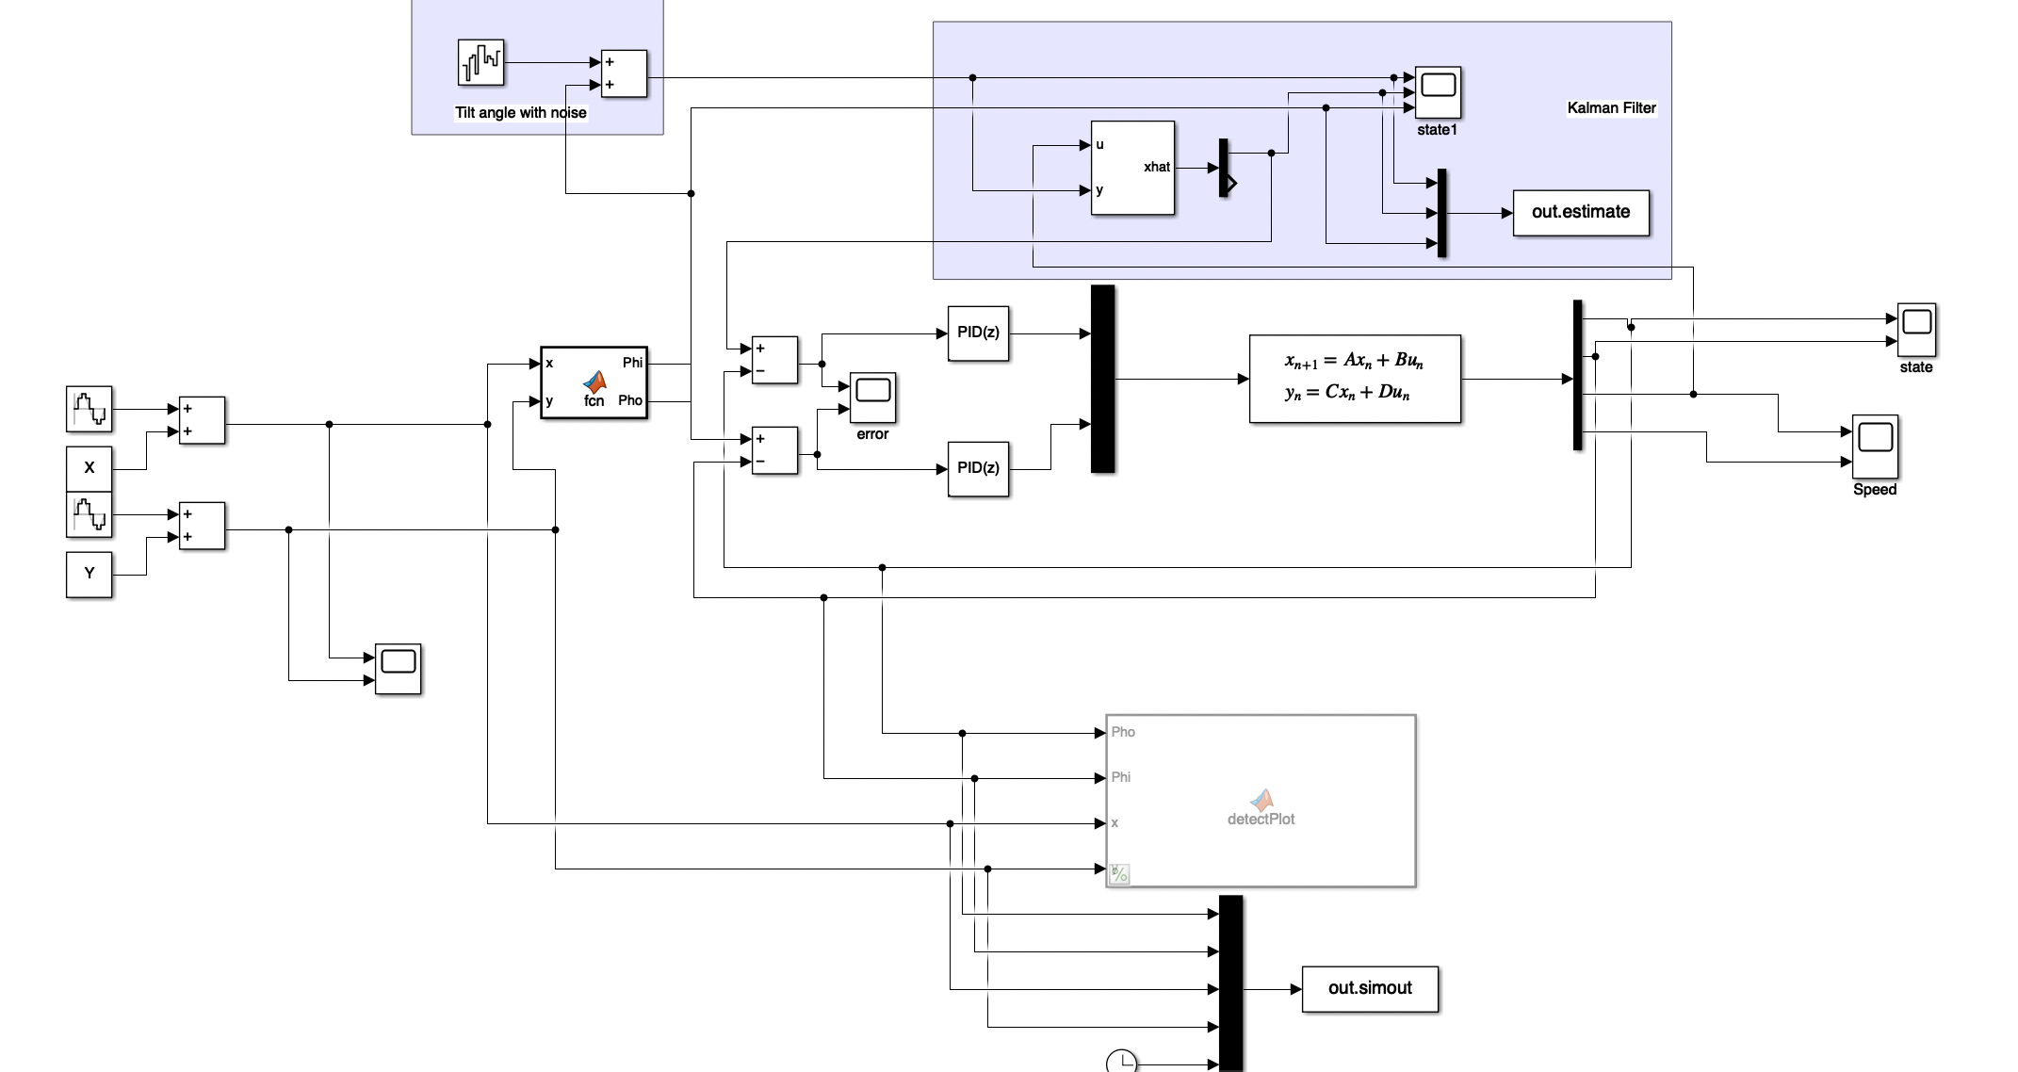
Kalman filter
In this part, I assume the measurement of desired pan angle in scenario 1 is no longer noise-free, the measurement is the true value add a band limit white noise. Assume we have no information regards the parameters of the white noise. I designed a Kalman filter to in the purple block to deal with the noise.

Slide 12
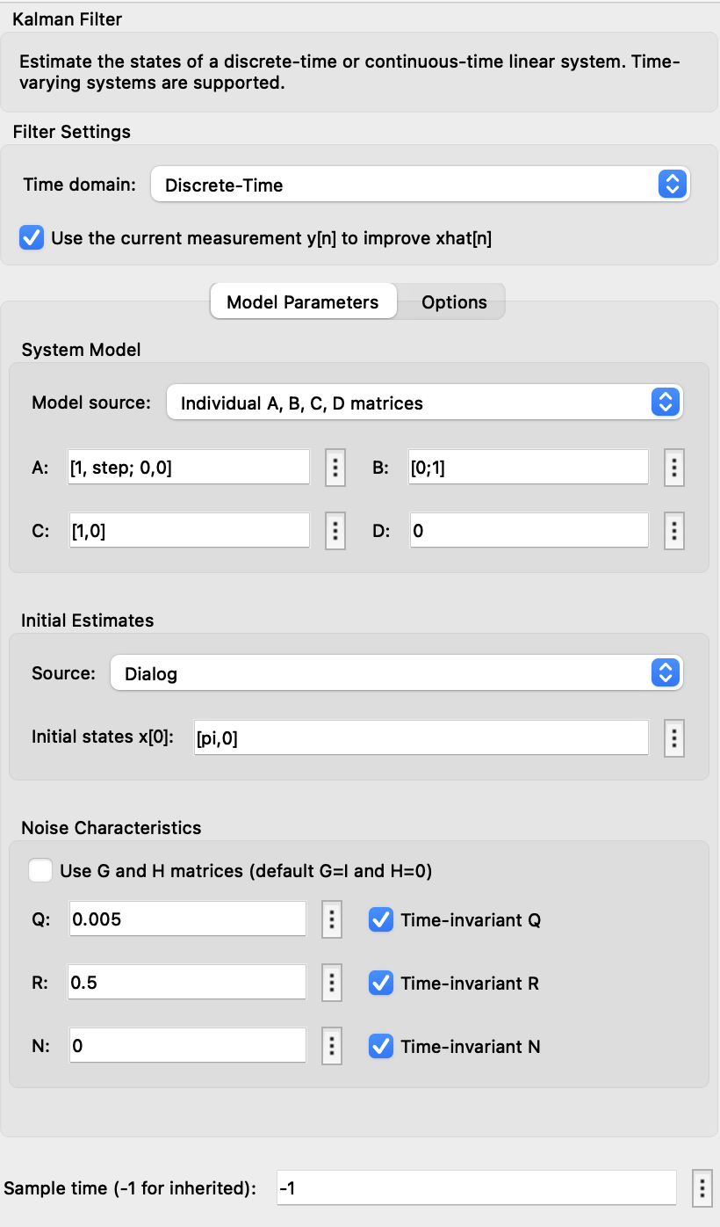
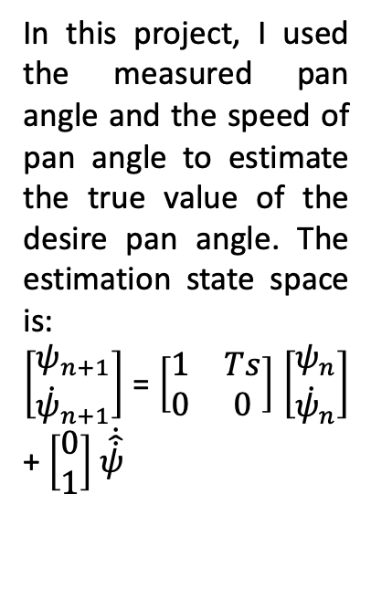
Kalman filter
Kalman filter's method is a two-step process: the first predicts the state of the system, and the second refines the estimate of system state using noise information.
State Estimation
Noise information
In this project, I used the measured pan angle and the speed of pan angle to estimate the true value of the desire pan angle. The estimation state space is:
$\left[\begin{aligned}ψ_{n+1} \\ {\dot{ψ}}_{n+1}\end{aligned}\right]$ = $\left[\begin{matrix}1 & Ts \\ 0 & 0\end{matrix}\right]$ $\left[\begin{aligned}ψ_{n} \\ {\dot{ψ}}_{n}\end{aligned}\right]$ + $\left[\begin{aligned}0 \\ 1\end{aligned}\right]$ $\dot{\hat{\dot{ψ}}}$
R is the covariance of the measurement noise.
Q is proportional to the square of the estimated velocities.
I will change the Q and R value to see how it influence the filter

Slide 13
Kalman filter
The comparison between true pan angle (yellow line), measured pan angle with noise (blue line) and pan angle estimation after different kinds of Kalman filter (orange line).
Q = 0.005,R = 0.5
Q = 0.05,R = 0.5
Q = 0.05,R = 2

Slide 14
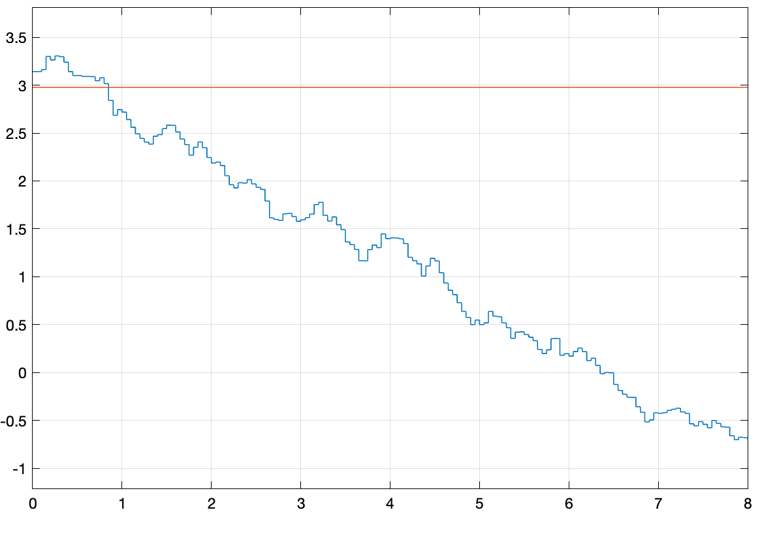
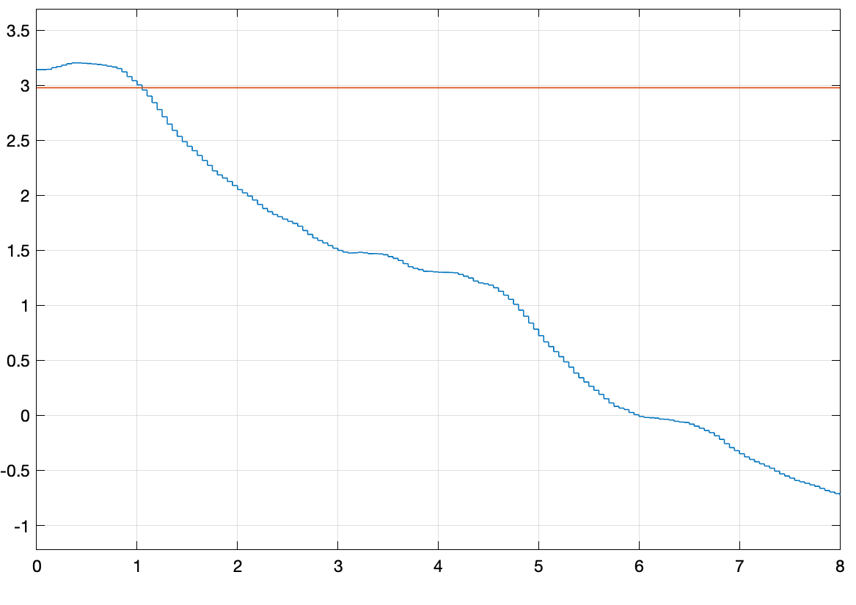
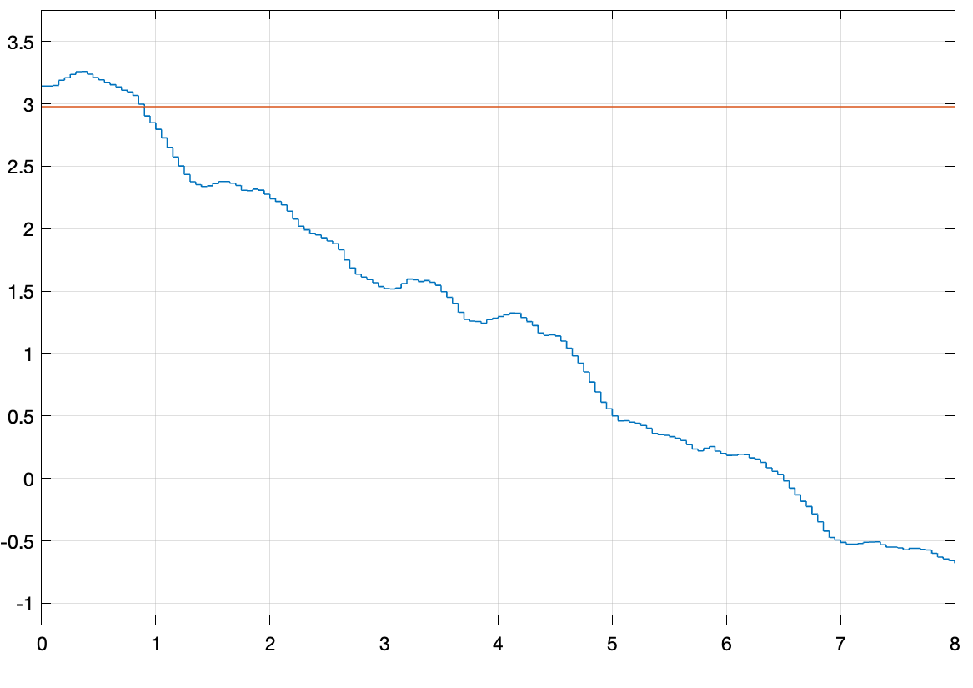
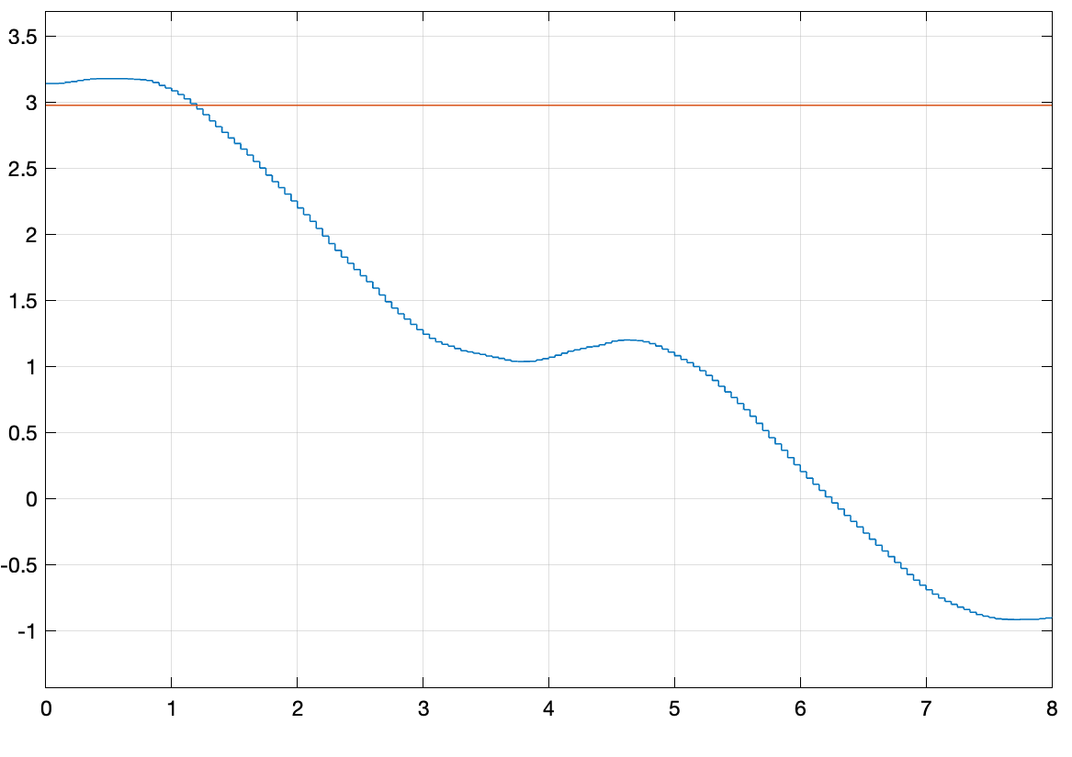
Kalman filter
The simulated states driven by the measured data. The blue line is pan angle.
Data with white noise
After Kalman filter
Q = 0.005,R = 0.5
After Kalman filter
Q = 0.05,R = 0.5
After Kalman filter
Q = 0.005,R = 2

Slide 15
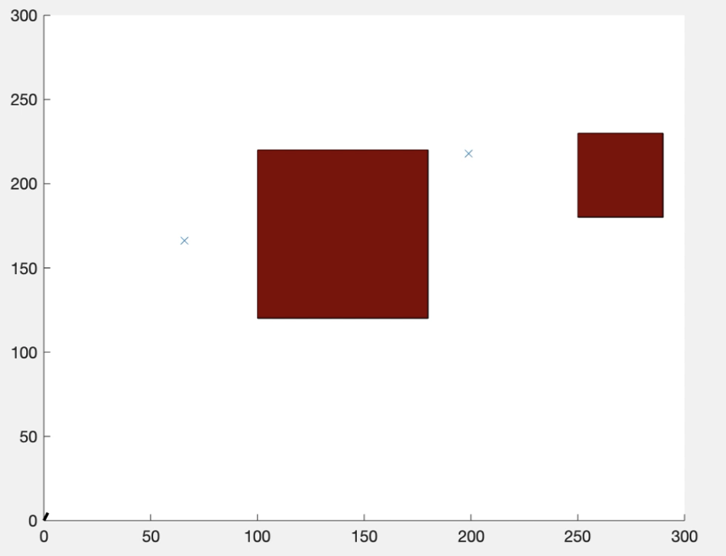
Path Planning Problem Description
The task is described as path planning for a CCTV in a museum. A laser light is attached with the PT camera. There are some expensive artworks on the bottom and we don’t want to directly light up them. As a result, the path of the center of FOV should avoid these areas. As described in this figure, the artworks are located in the red areas. And the target of this task is to move from (0,0) to (3,3) and the units in the graph are centimeters.

Slide 16
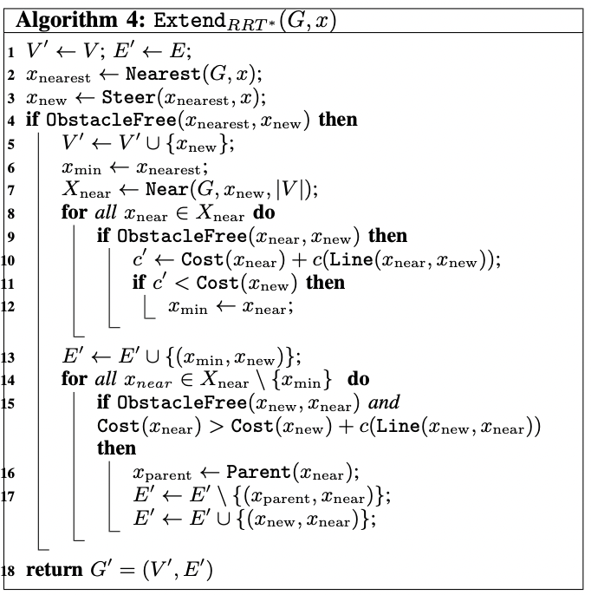
RRT* Path Planning
In this project, we used Rapidly-exploring Random Tree* to plan the optimal obstacle-free path for the camera. The core of the algorithm follow the steps illustrated in Figure 9
Figure 9: RRT* Pseudocode[1]
[1] Karaman, Sertac, and Emilio Frazzoli. "Incremental sampling-based algorithms for optimal motion planning." Robotics Science and Systems VI 104 (2010).

Slide 17
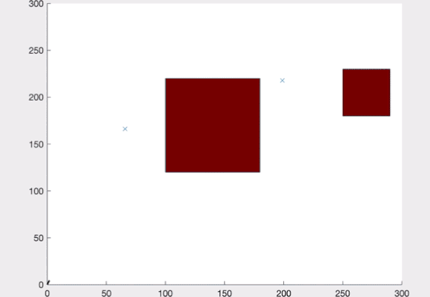
RRT* Path Planning
The planning process is shown in video 3. The final result is obstacle-free. And the planning process also tries to find the path with shortest distance.
Video 3: RRT* planning process
[2] SAI VEMPRALA (2021). 2D/3D RRT* algorithm (https://www.mathworks.com/matlabcentral/fileexchange/60993-2d-3d-rrt-algorithm), MATLAB Central File Exchange. Retrieved December 1, 2021.

Slide 18
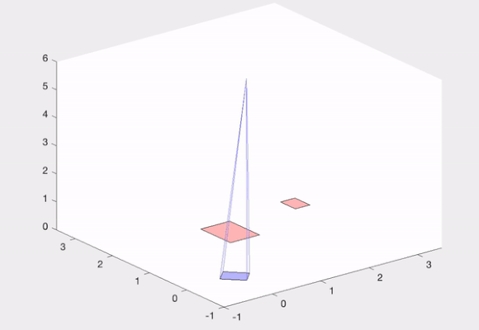
RRT* Path Planning
The moving of the PT camera follow the optimal path in video 3 is shown in video 4. As illustrated in the video the FOV doesn’t collide with the artworks which are the red areas.
Video 4: planned path tracking

